Slide 1

Introduction to Xamarin.Forms
Beginner Track
Bryan Anthony Garcia, Microsoft MVP for Developer Technologies

Slide 2
Xamarin Workshop
Beginners
(Today)
Intermediate
Advanced
Introduction
Cross Platform UI
Adding Behavior and Effects
MVVM
Consuming Web Services
Xamarin.Essentials
Advanced UI (Styles, Custom Renderers, etc)
Dealing with Database
Caching
Map Integration
Cloud Service Integration
Push Notifications
App Center
Distribution
Etc.

Slide 3
Introduction to Xamarin.Forms
Beginner Track
Bryan Anthony Garcia, Microsoft MVP for Developer Technologies

Slide 4
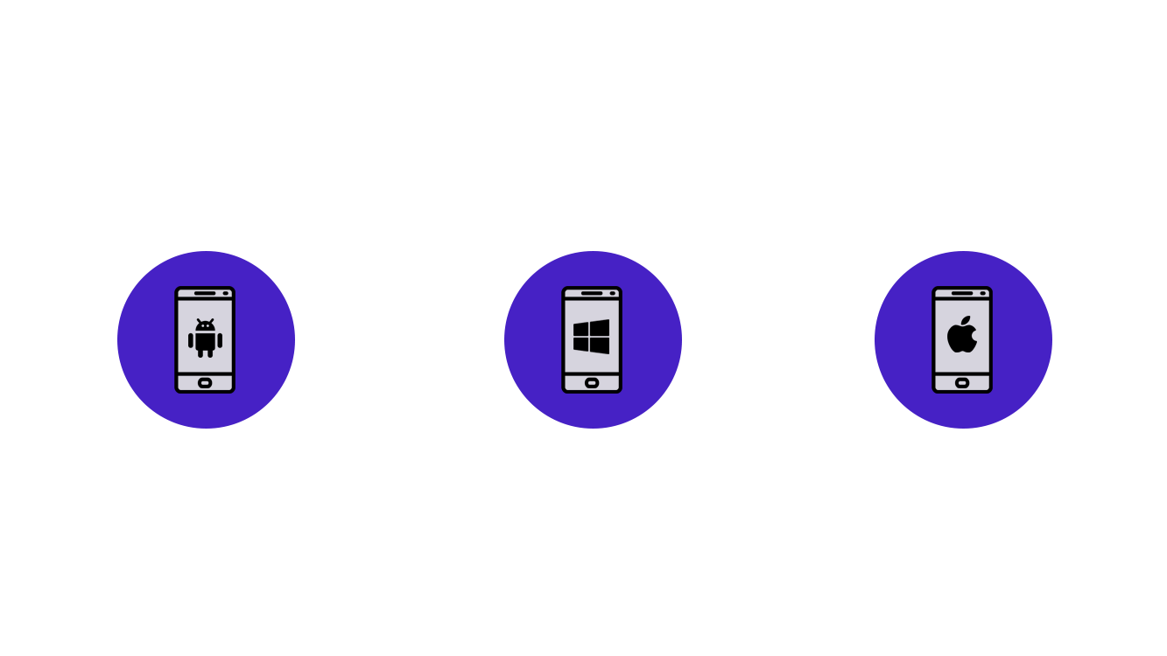
Traditional Development Approach

Slide 5
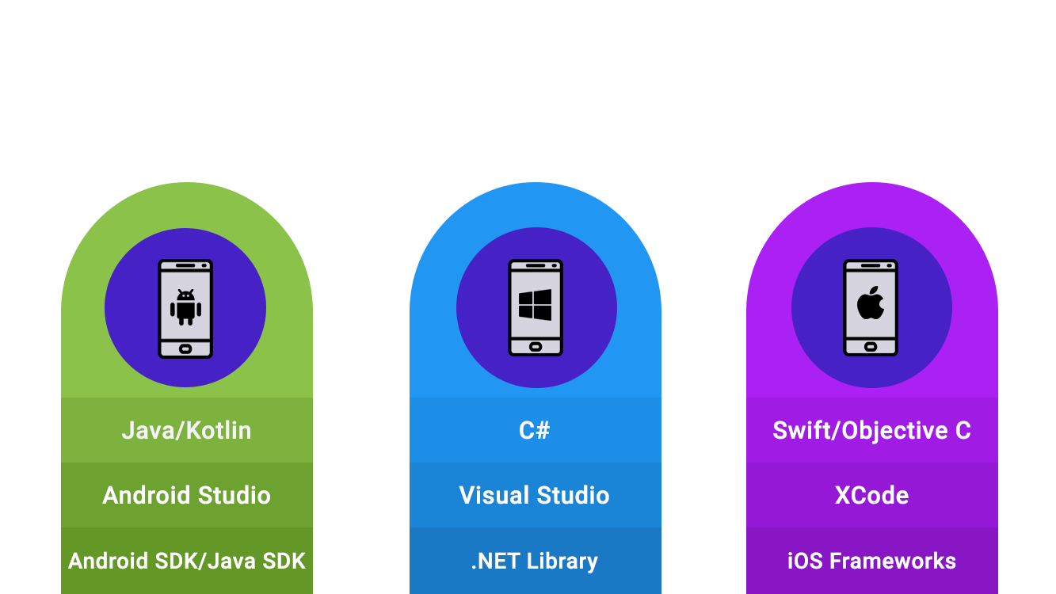
Traditional Development Approach

Slide 6
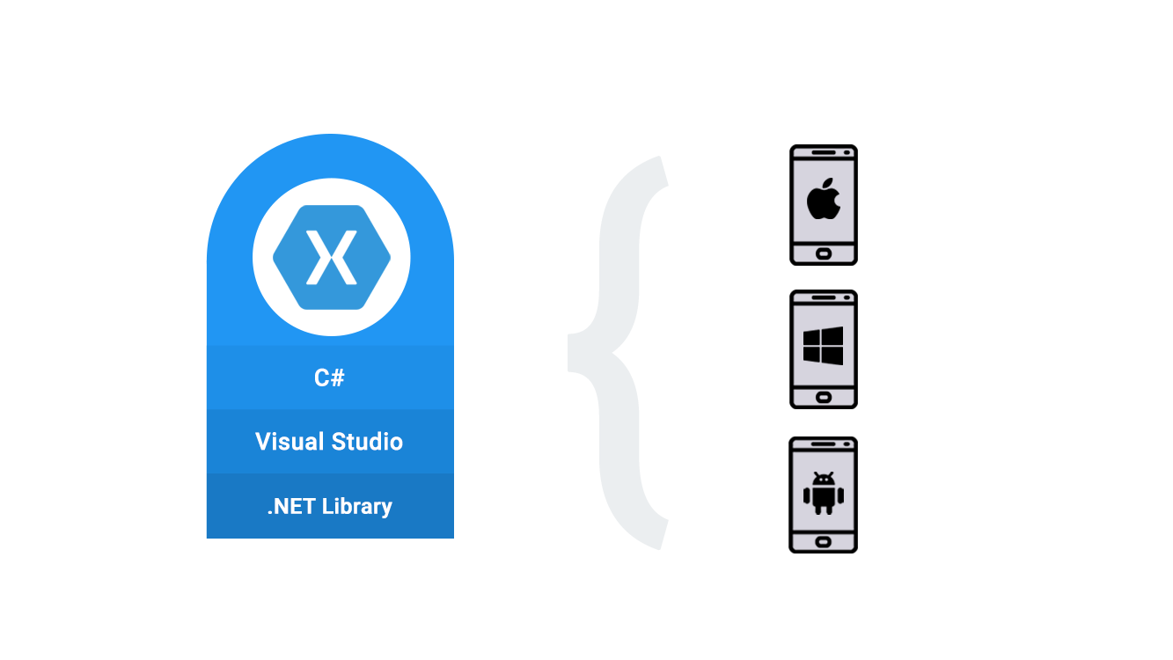
The Xamarin Approach

Slide 7
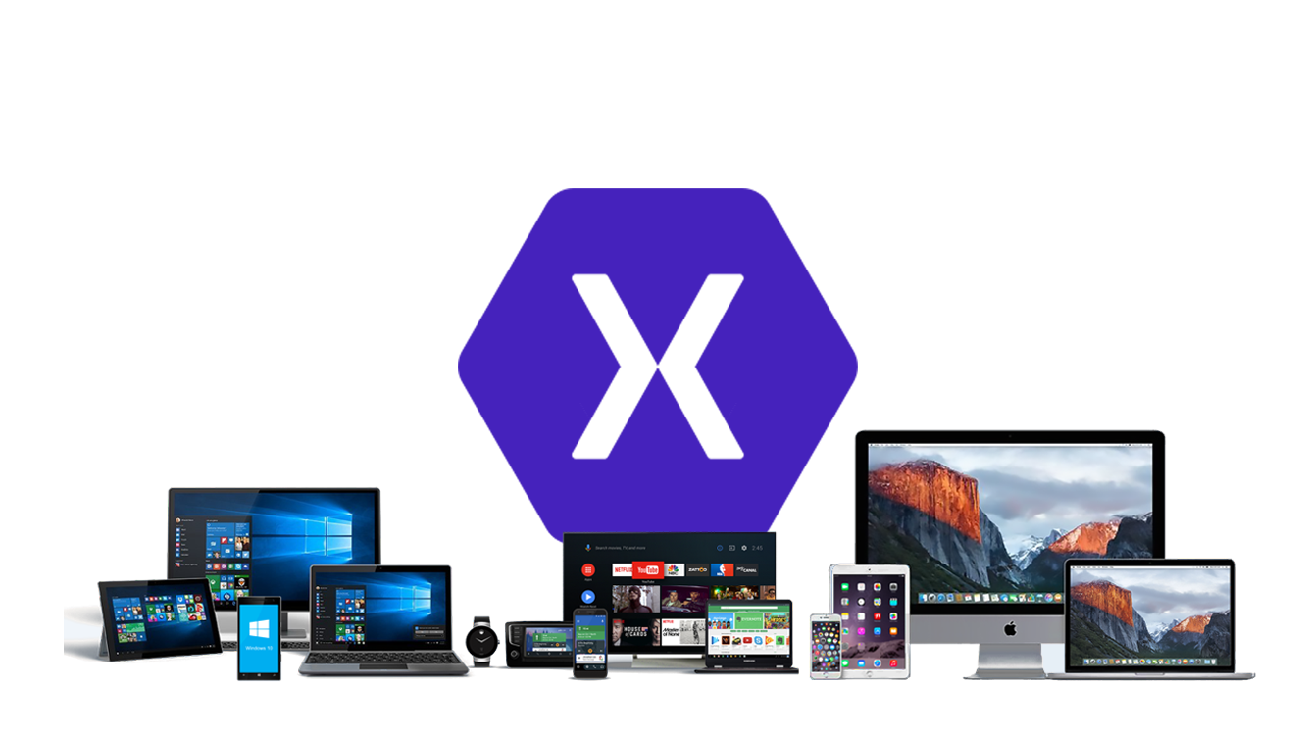
Develop a native app once, run it everywhere!

Slide 8
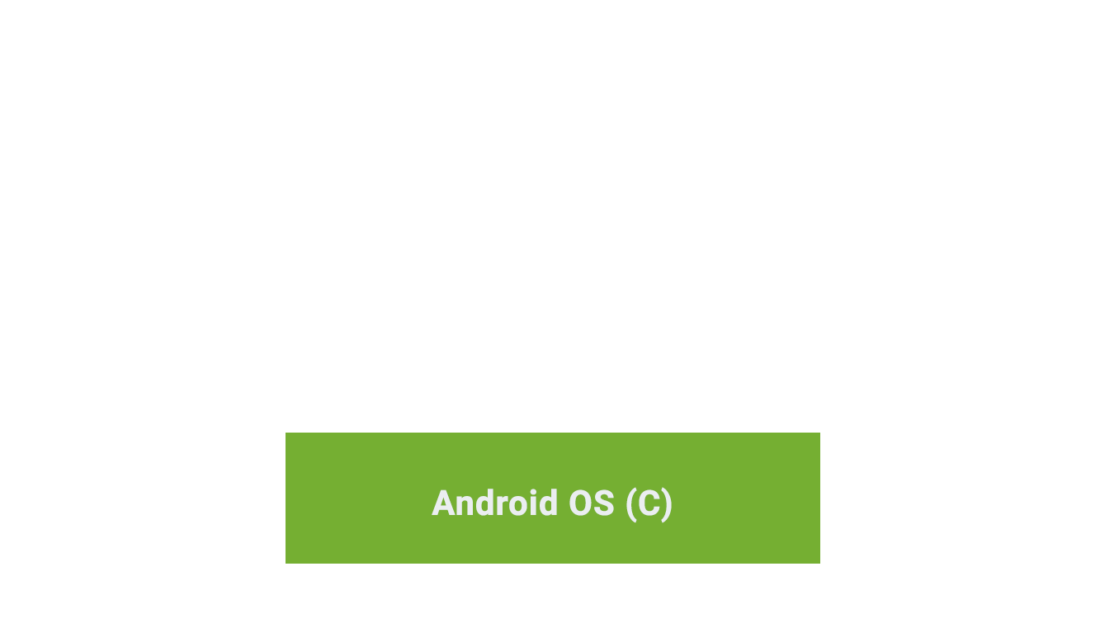
Xamarin.Android Architecture

Slide 9
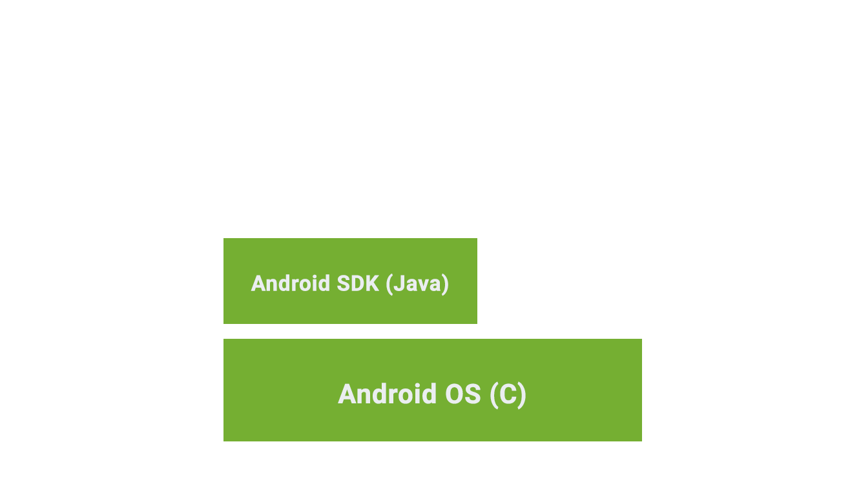
Xamarin.Android Architecture

Slide 10
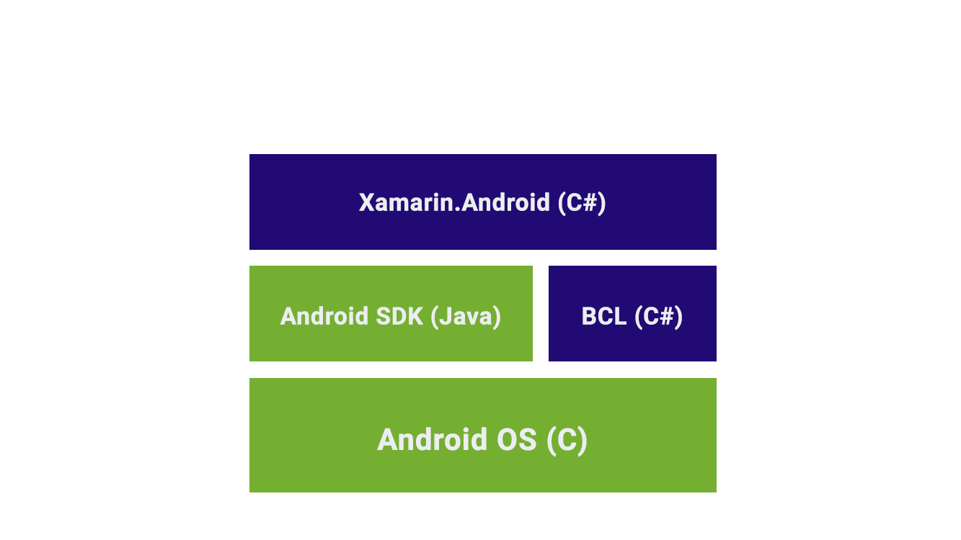
Xamarin.Android Architecture

Slide 11
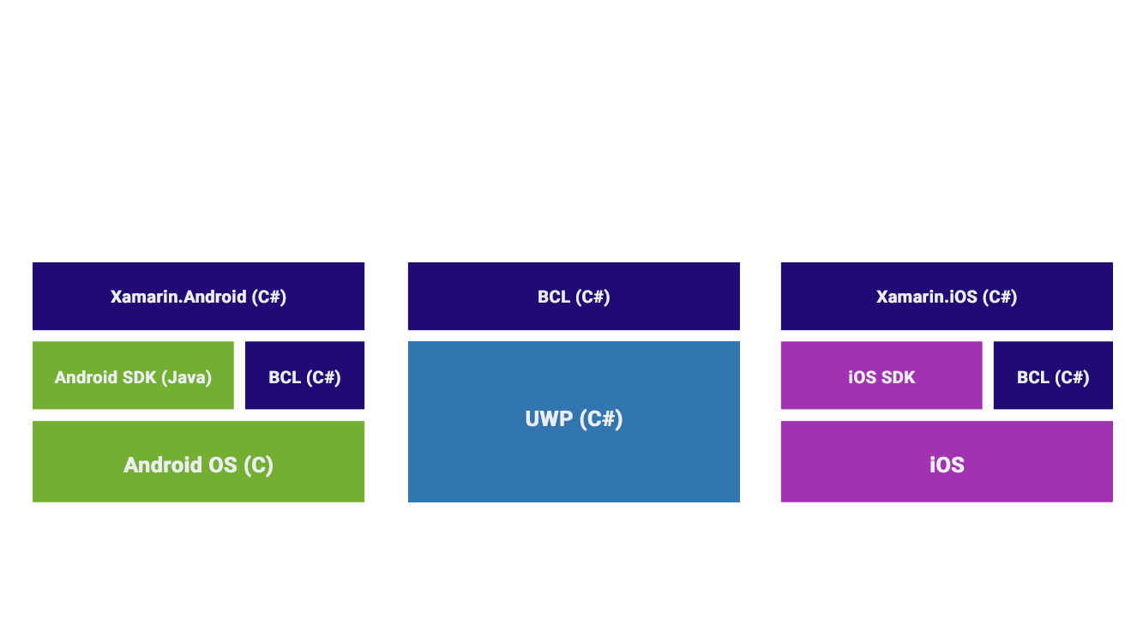
Xamarin Native Architecture

Slide 12
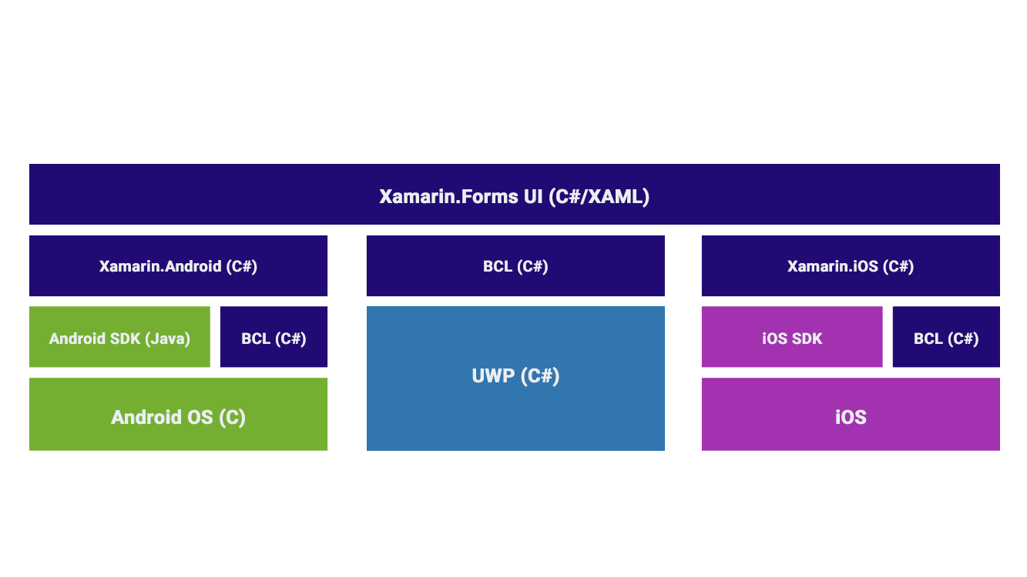
Xamarin.Forms Architecture

Slide 13
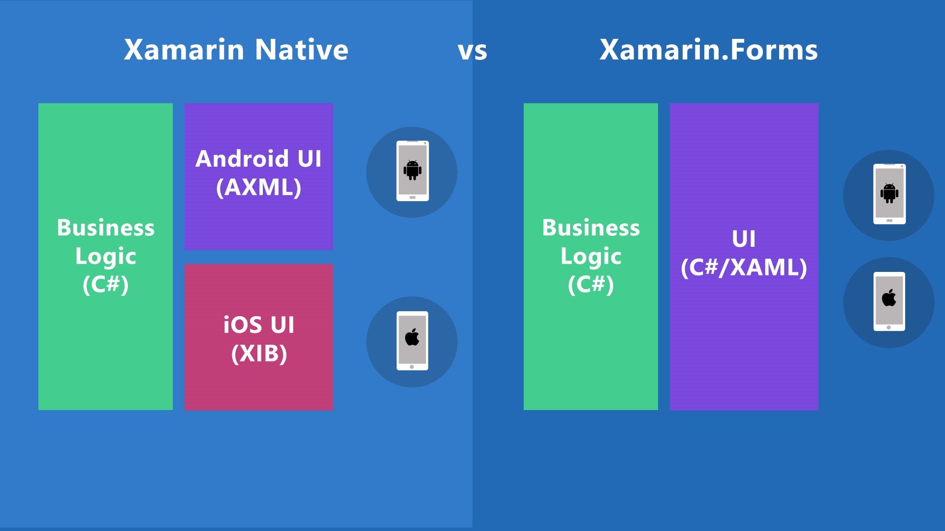

vs
Xamarin Native
Xamarin.Forms

Slide 14
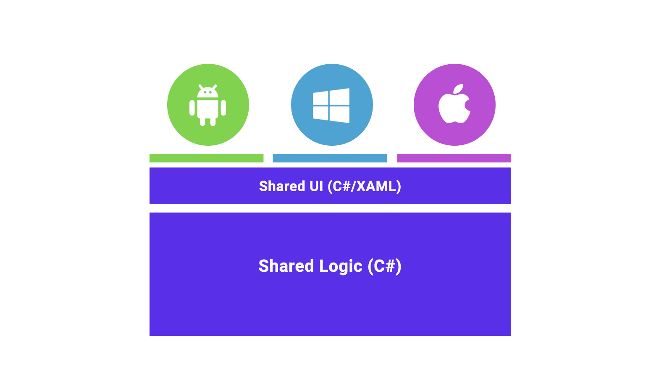
Xamarin.Forms: Share UI and logic across all platforms

Slide 15
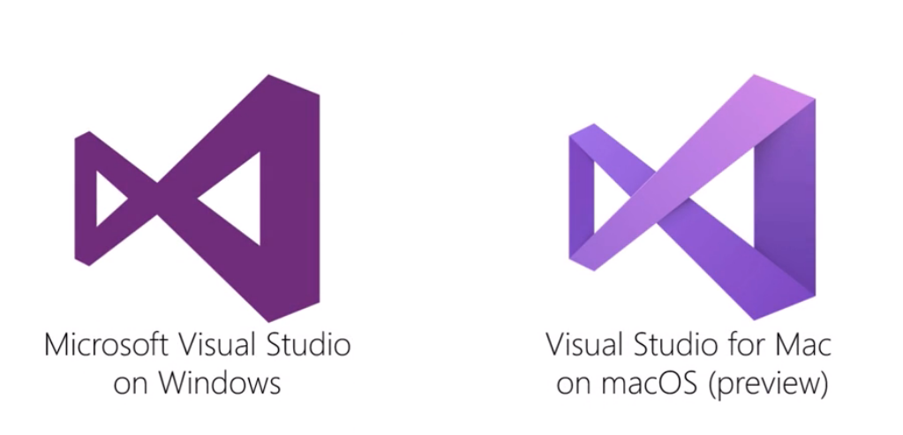
Develop on Windows or Mac

Slide 16
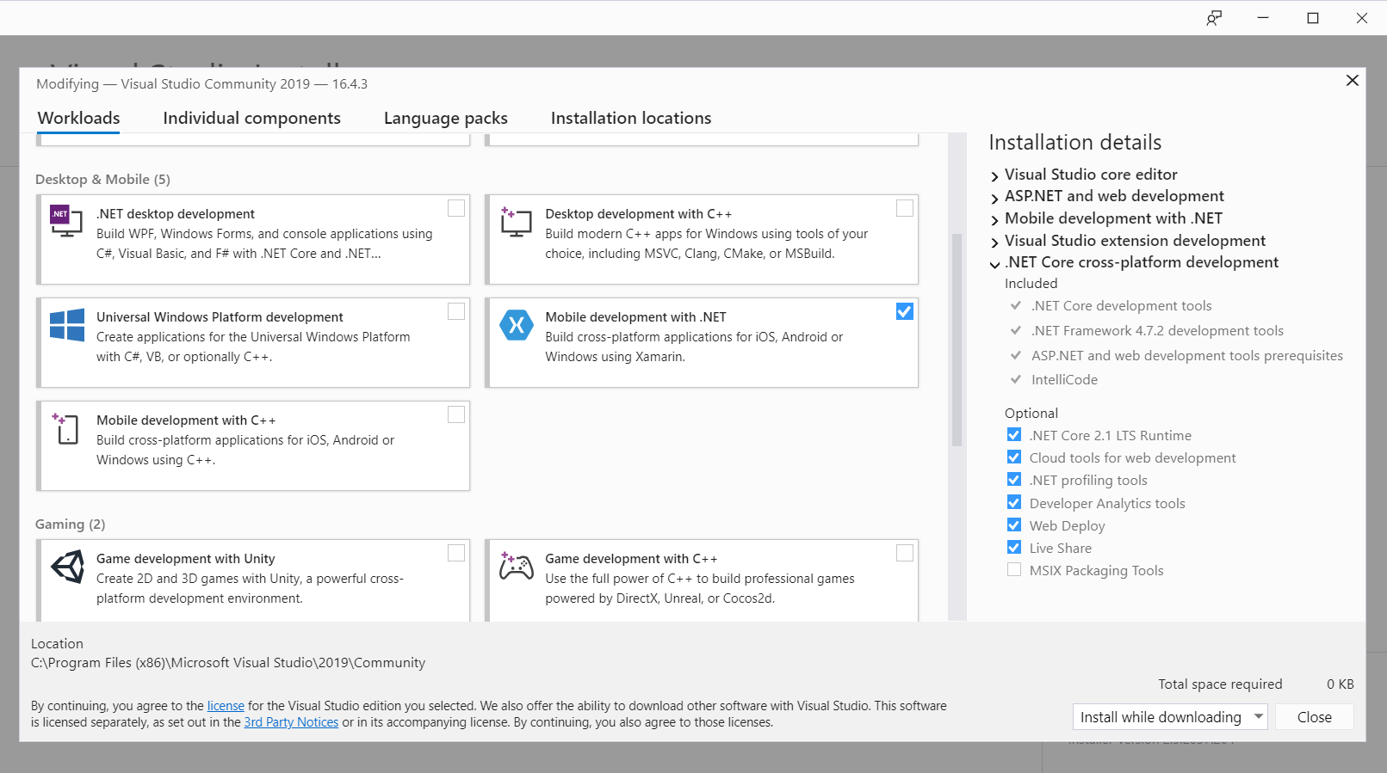
Installing Xamarin Development in Visual Studio 2019

Slide 17
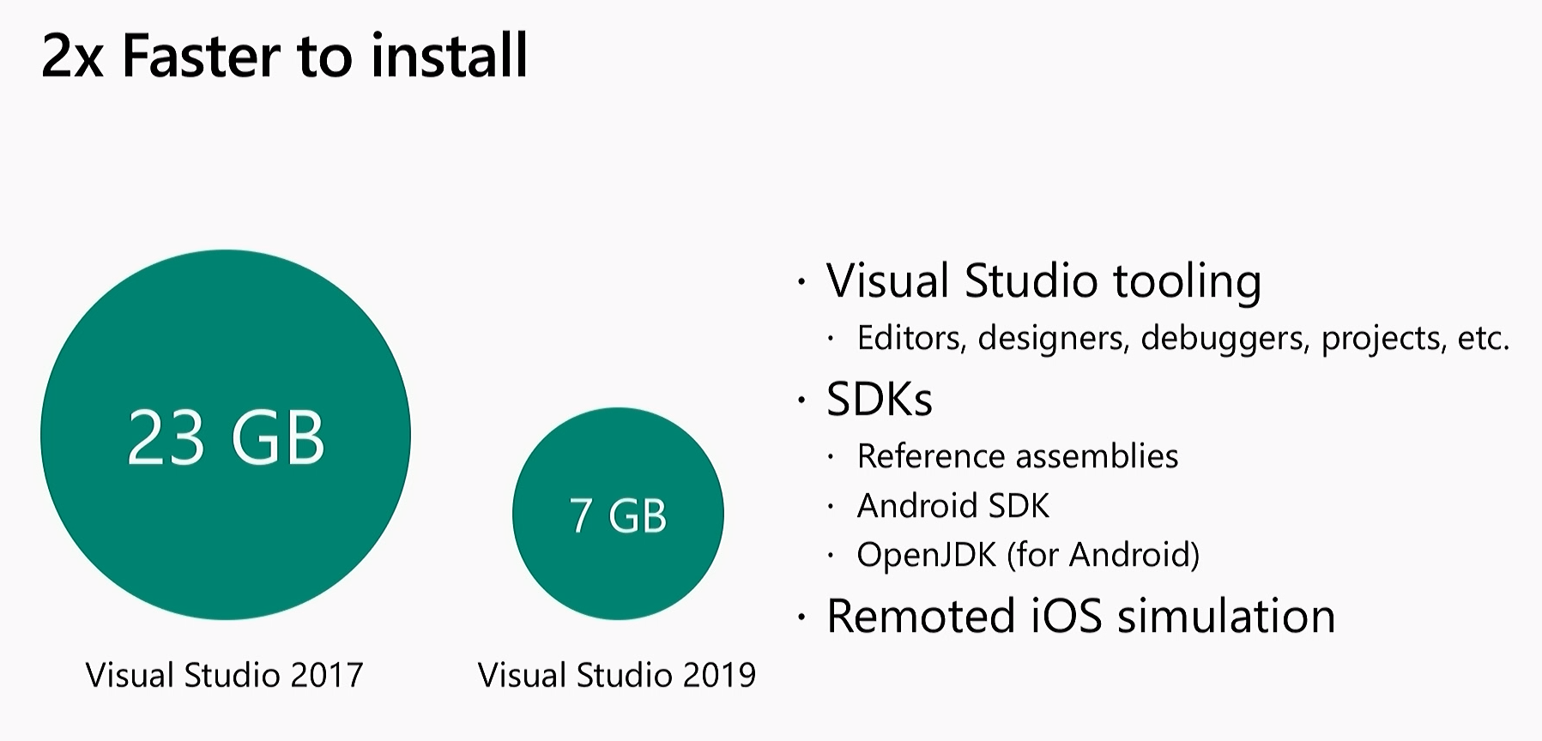
Visual Studio 2017 vs Visual Studio 2019

Slide 18
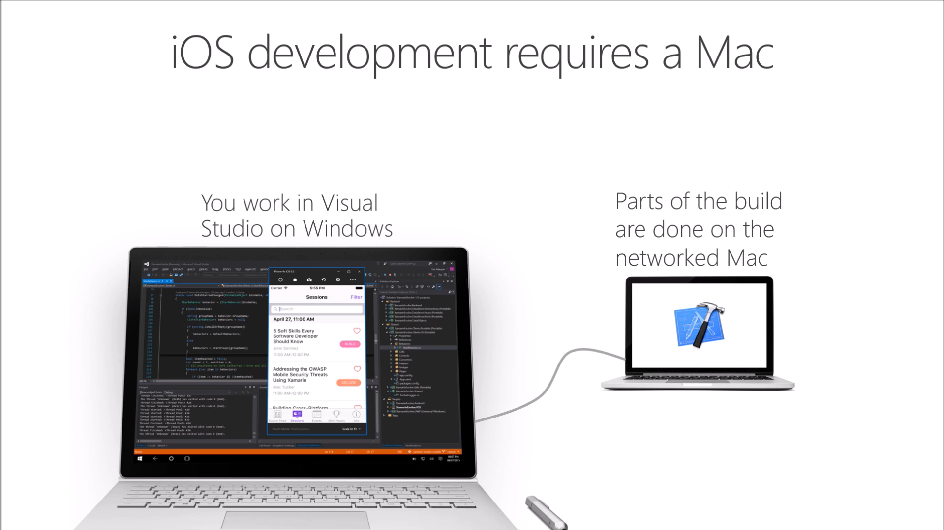

Slide 19
Demo
Creating your first Xamarin.Forms App

Slide 20
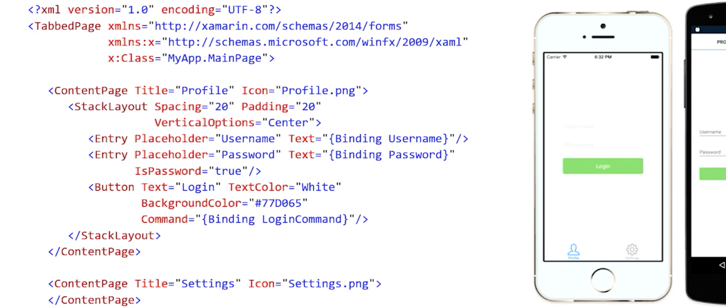
Define your UI in XAML

Slide 21
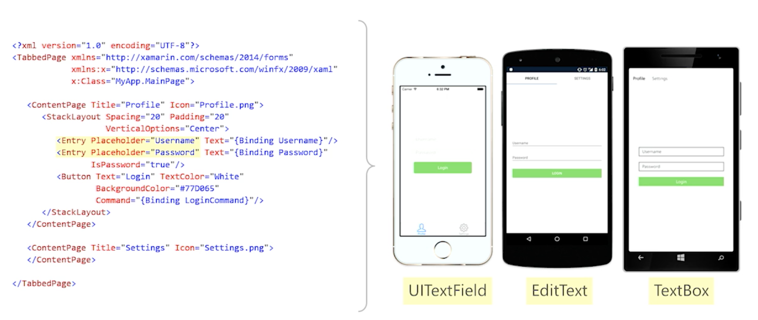
Native Controls are used at runtime

Slide 22
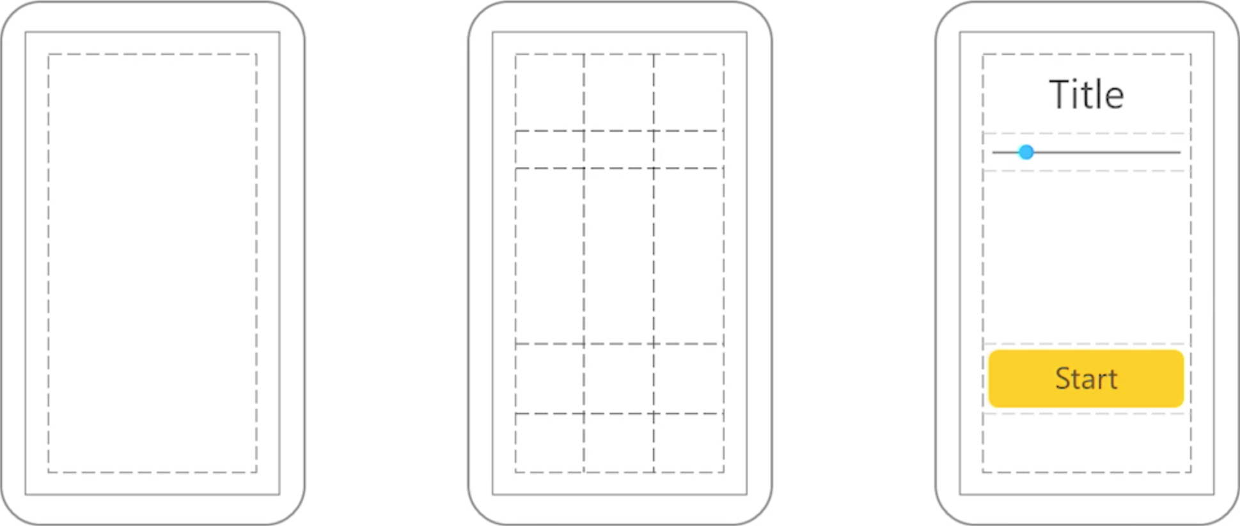
Xamarin.Forms UI Elements
Pages
Layouts
Controls

Slide 23
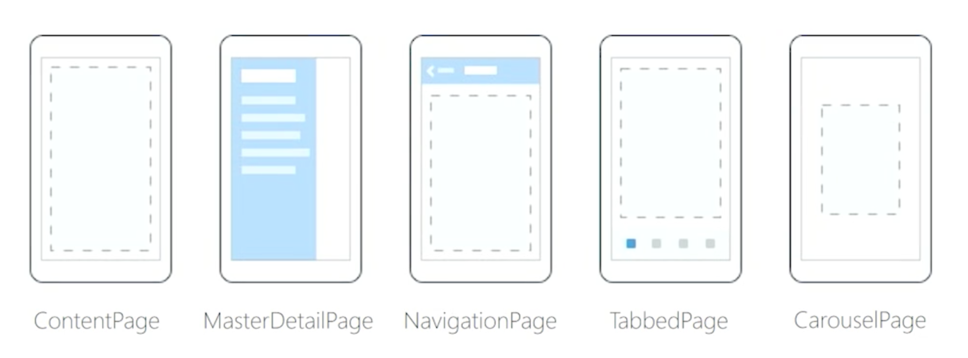
Xamarin.Forms Pages

Slide 24
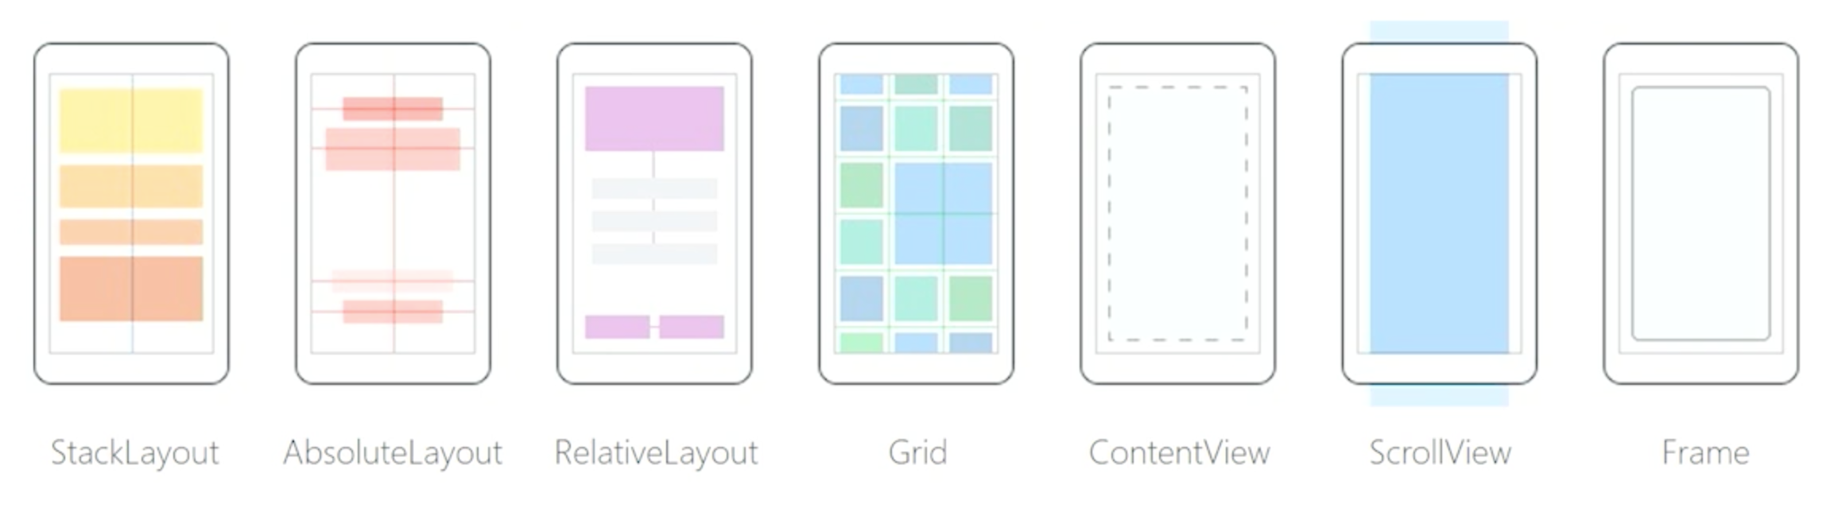
Xamarin.Forms Layouts

Slide 25
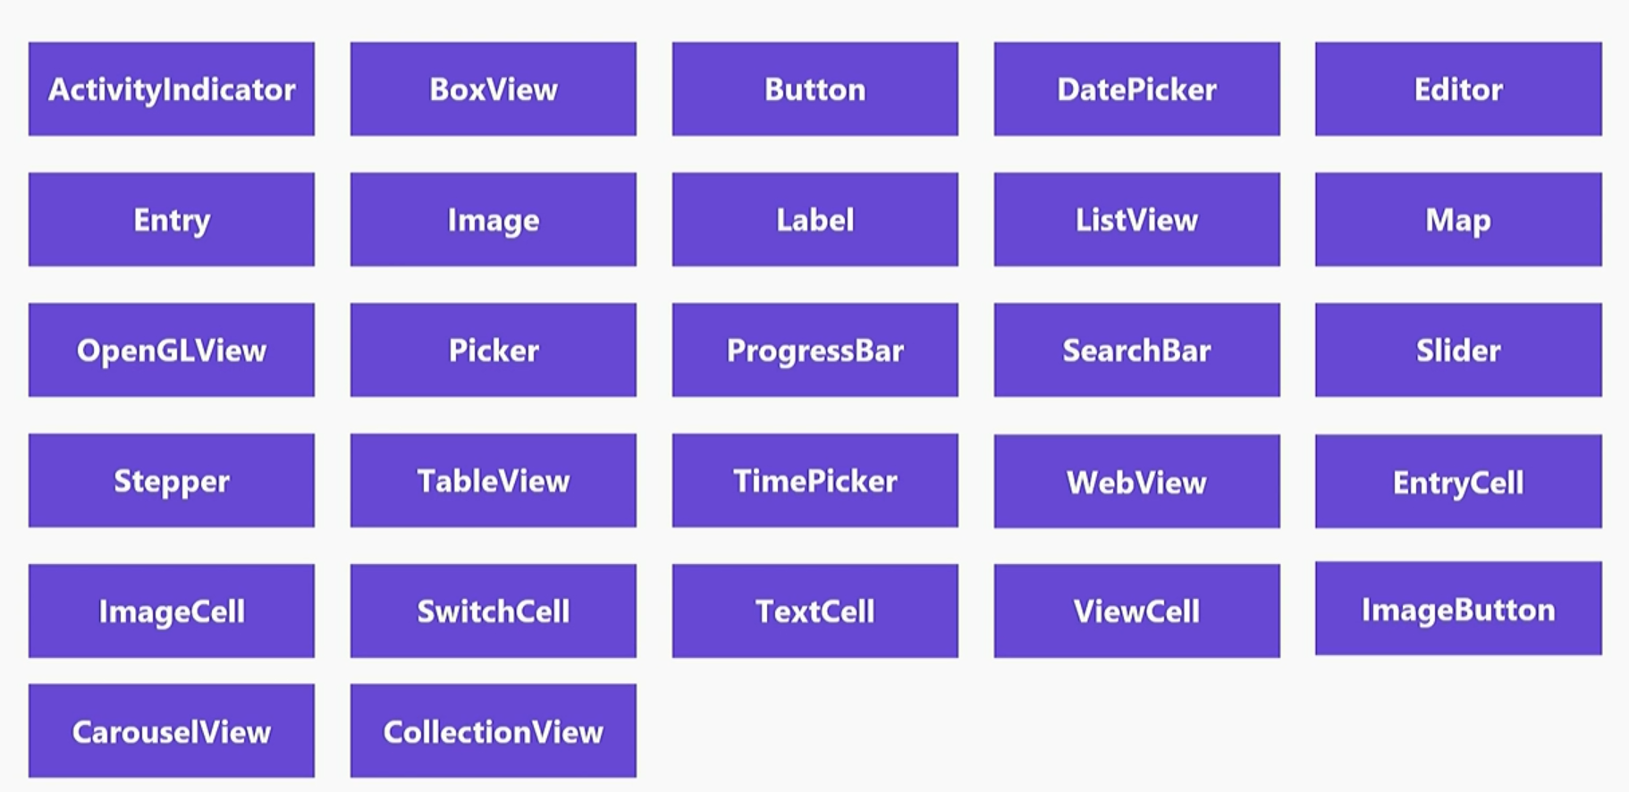
Xamarin.Forms Controls

Slide 26
Demo
Let’s add our first control!

Slide 27
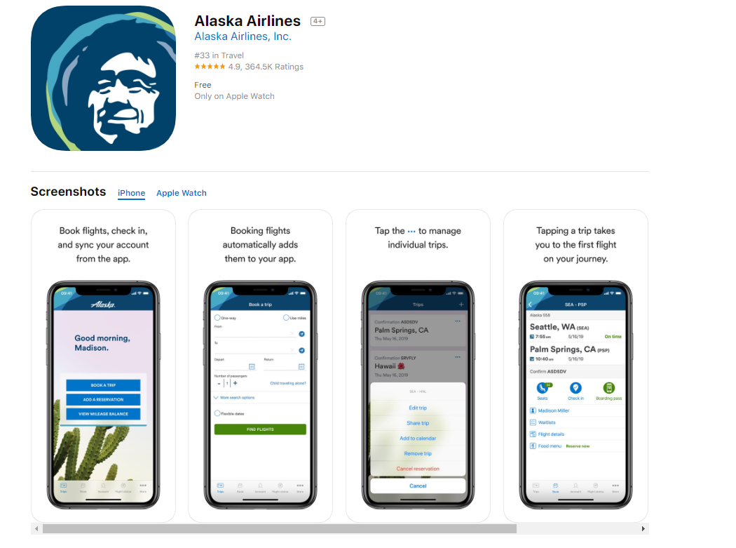
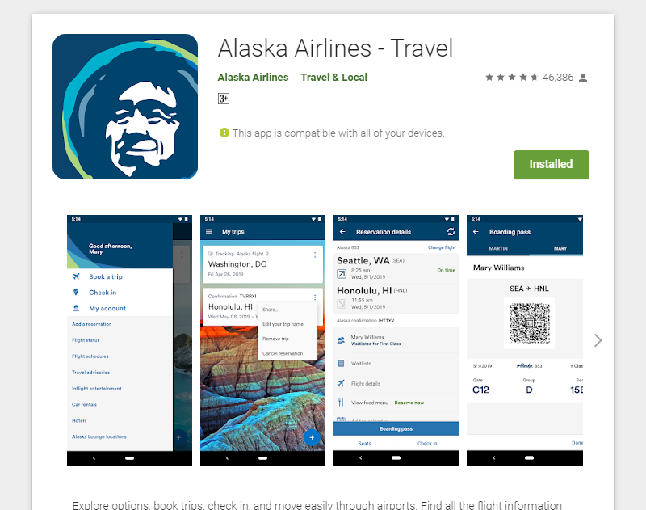
Xamarin.Forms is NOT just creating forms apps!

Slide 28

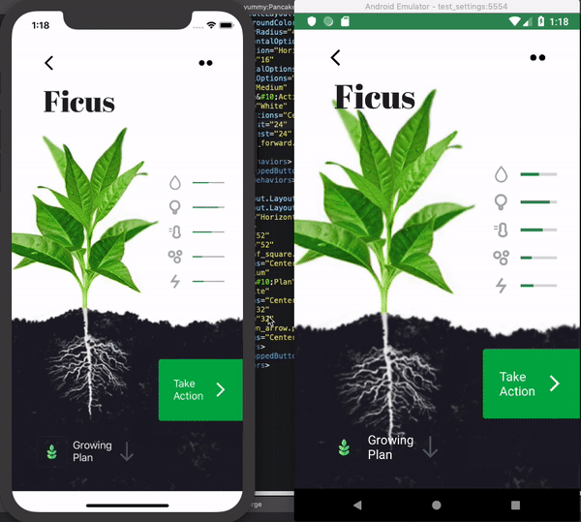

Xamarin.Forms is NOT just creating forms apps!
https://github.com/jsuarezruiz/xamarin-forms-goodlooking-UI

Slide 29

Develop once, run everywhere
Do more with less
We want more!

Slide 30
Xamarin screams PRODUCTIVITY!

Slide 31
Demo
Hot Reload

Slide 32
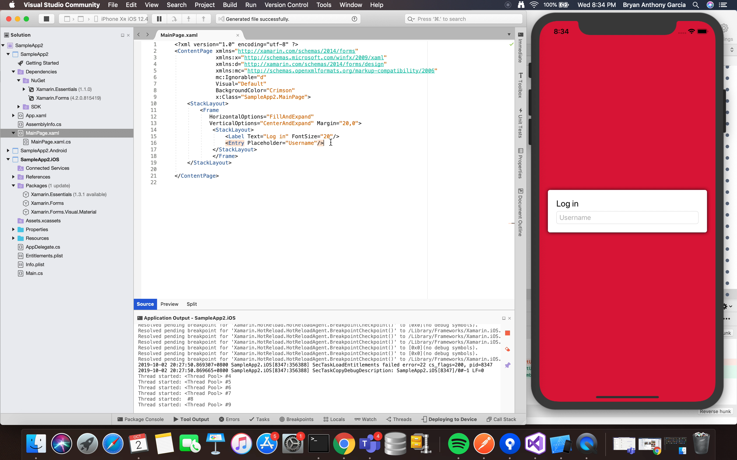
Demo
Hot Restart

Slide 33
Demo
Hot Restart Partial Preview

Slide 34
Thank you!
Shoot your Questions!
Bryan Anthony Garcia, Microsoft MVP for Developer Technologies

